Slide 1

News Pulse
Ashwanth

Slide 2

Team Members-Group 3
Ashwanth Reddy Cheemarla
GopichandChandana
Roshini Bikkina
Tejaswini Kotha
Ashwanth

Slide 3
Project Outline
Introduction
Proposed Solution
Features
Problems faced
Future Improvements
Ashwanth

Slide 4
Introduction
News Pulse is an innovative news reporting application that aims to solve the problem of information overload by delivering a personalized and reliable news consumption experience.
The application will consist of several key activities, each serving a distinct purpose
Ashwanth

Slide 5

PROPOSED SOLUTION
Newspulse is an awesome app for your Android phone. It helps you with too much news by giving you exactly what you like. With its easy-to-use design and personalized news feed, Newspulse makes sure you get the news you want, right when it happens, so you don't miss anything important to you.
Ashwanth

Slide 6
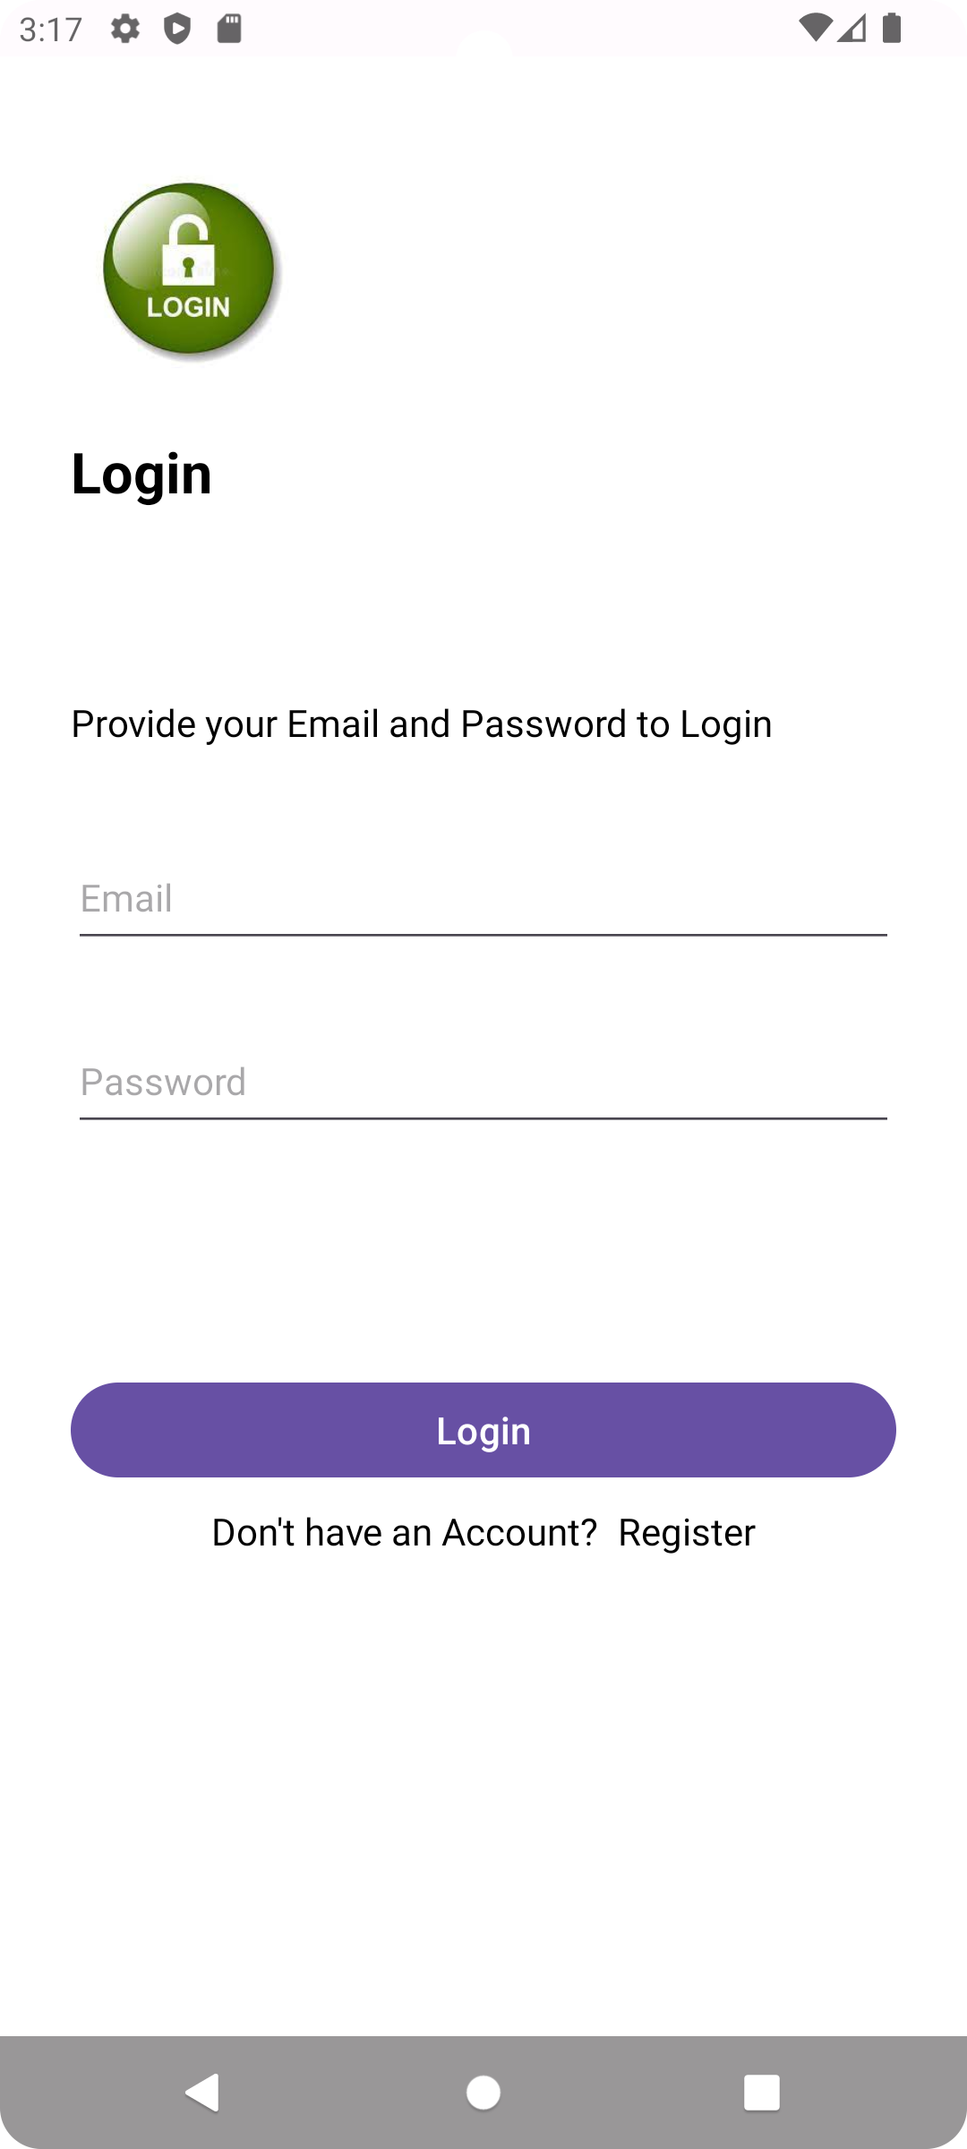
Login Page
In News Pulse, we've implemented Firebase email authentication for a secure login process. Users can enter their registered email and password to access personalized news feeds, ensuring a safe and tailored experience.
Roshini

Slide 7
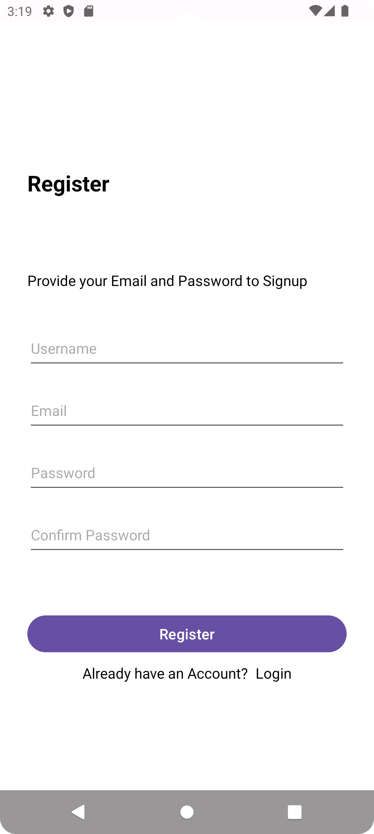
Register Page
Users can easily register for News Pulse by providing a unique username, valid email, password, and confirming their password. This ensures a straightforward and secure registration process.
Roshini

Slide 8
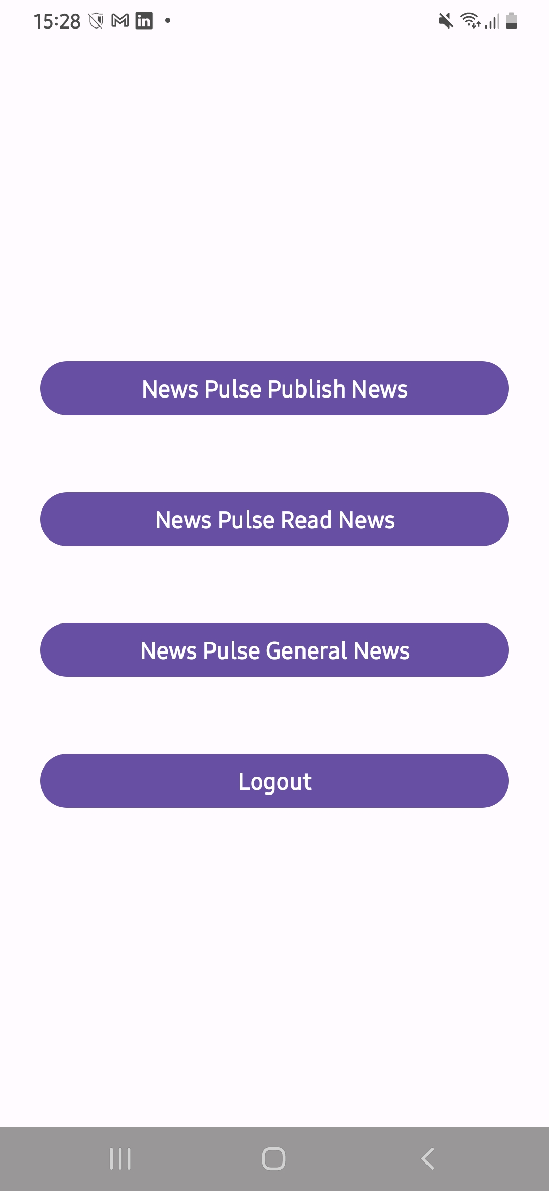
Dashbord
The News Pulse dashboard offers convenient access to key features, including publishing news, reading updates, exploring general news, and logging out for a seamless user experience.
Roshini

Slide 9
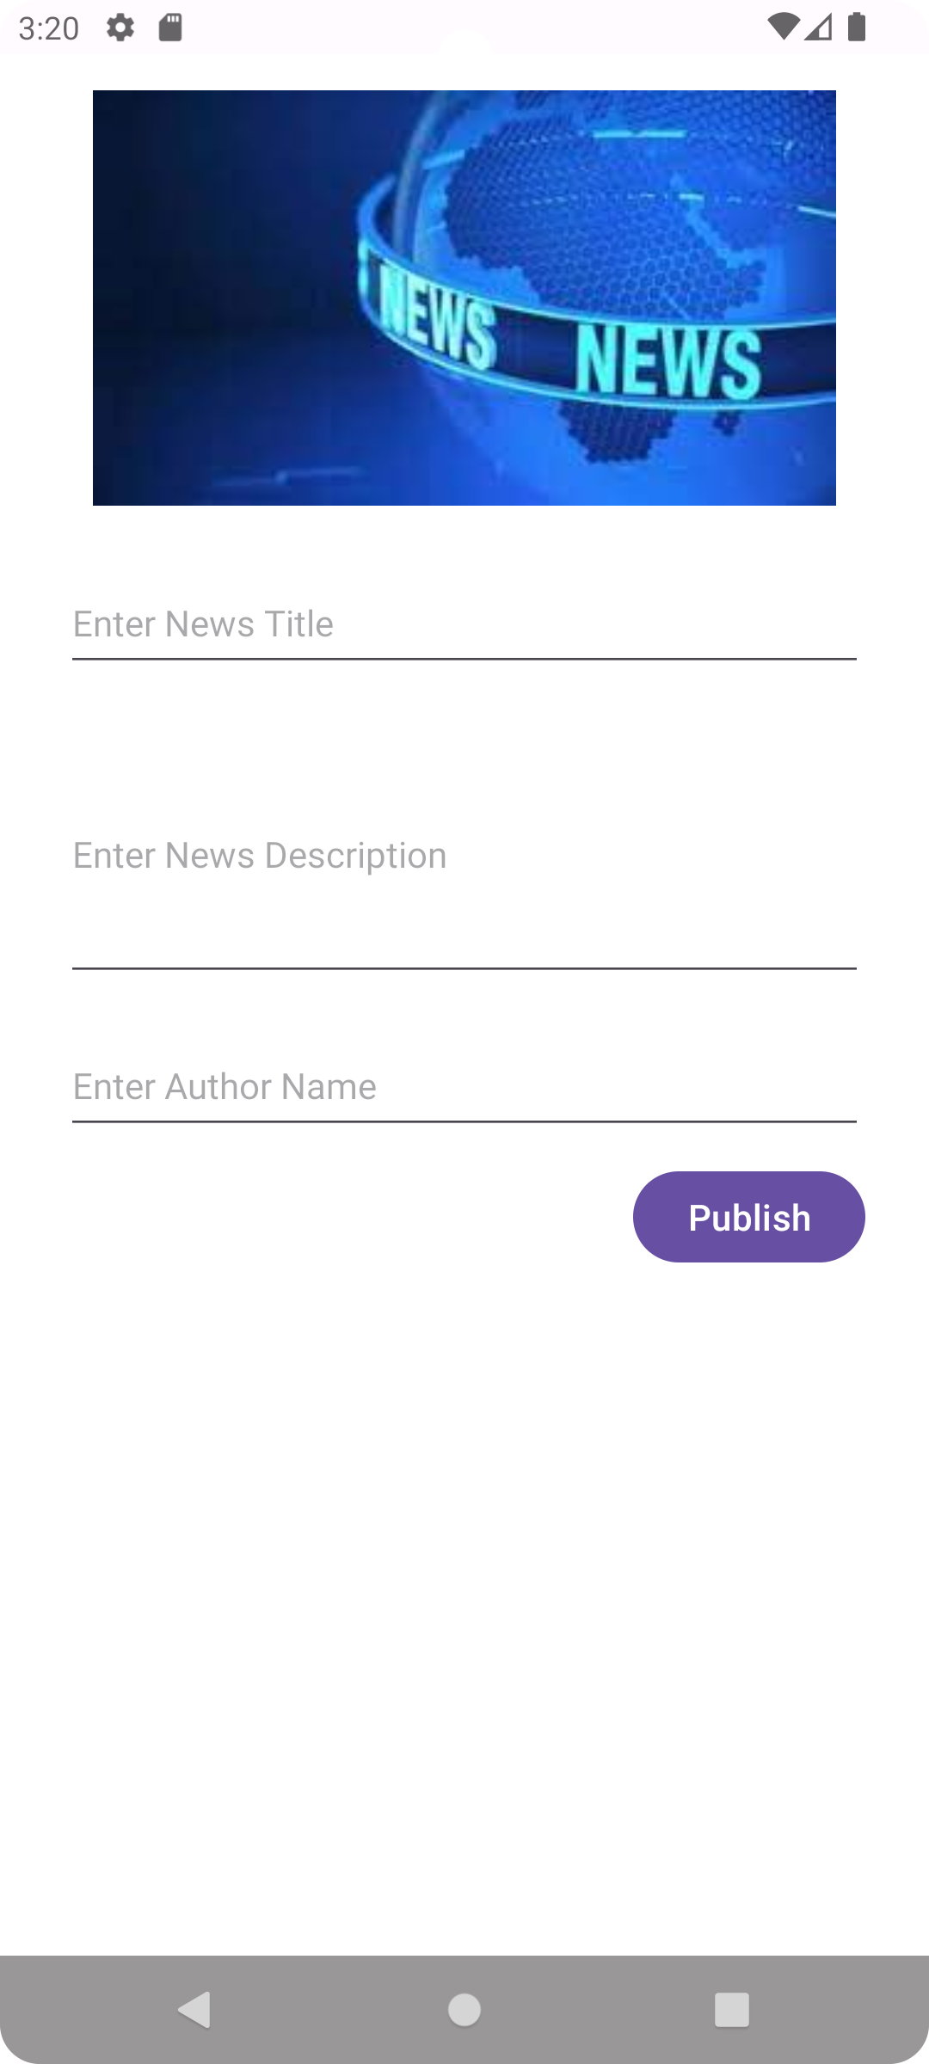
Publish news
In the 'Publish News' section of News Pulse, users can input the news title, provide a detailed description, enter the author's name, and then publish the news with a single click using the 'Publish' button.
Roshini

Slide 10
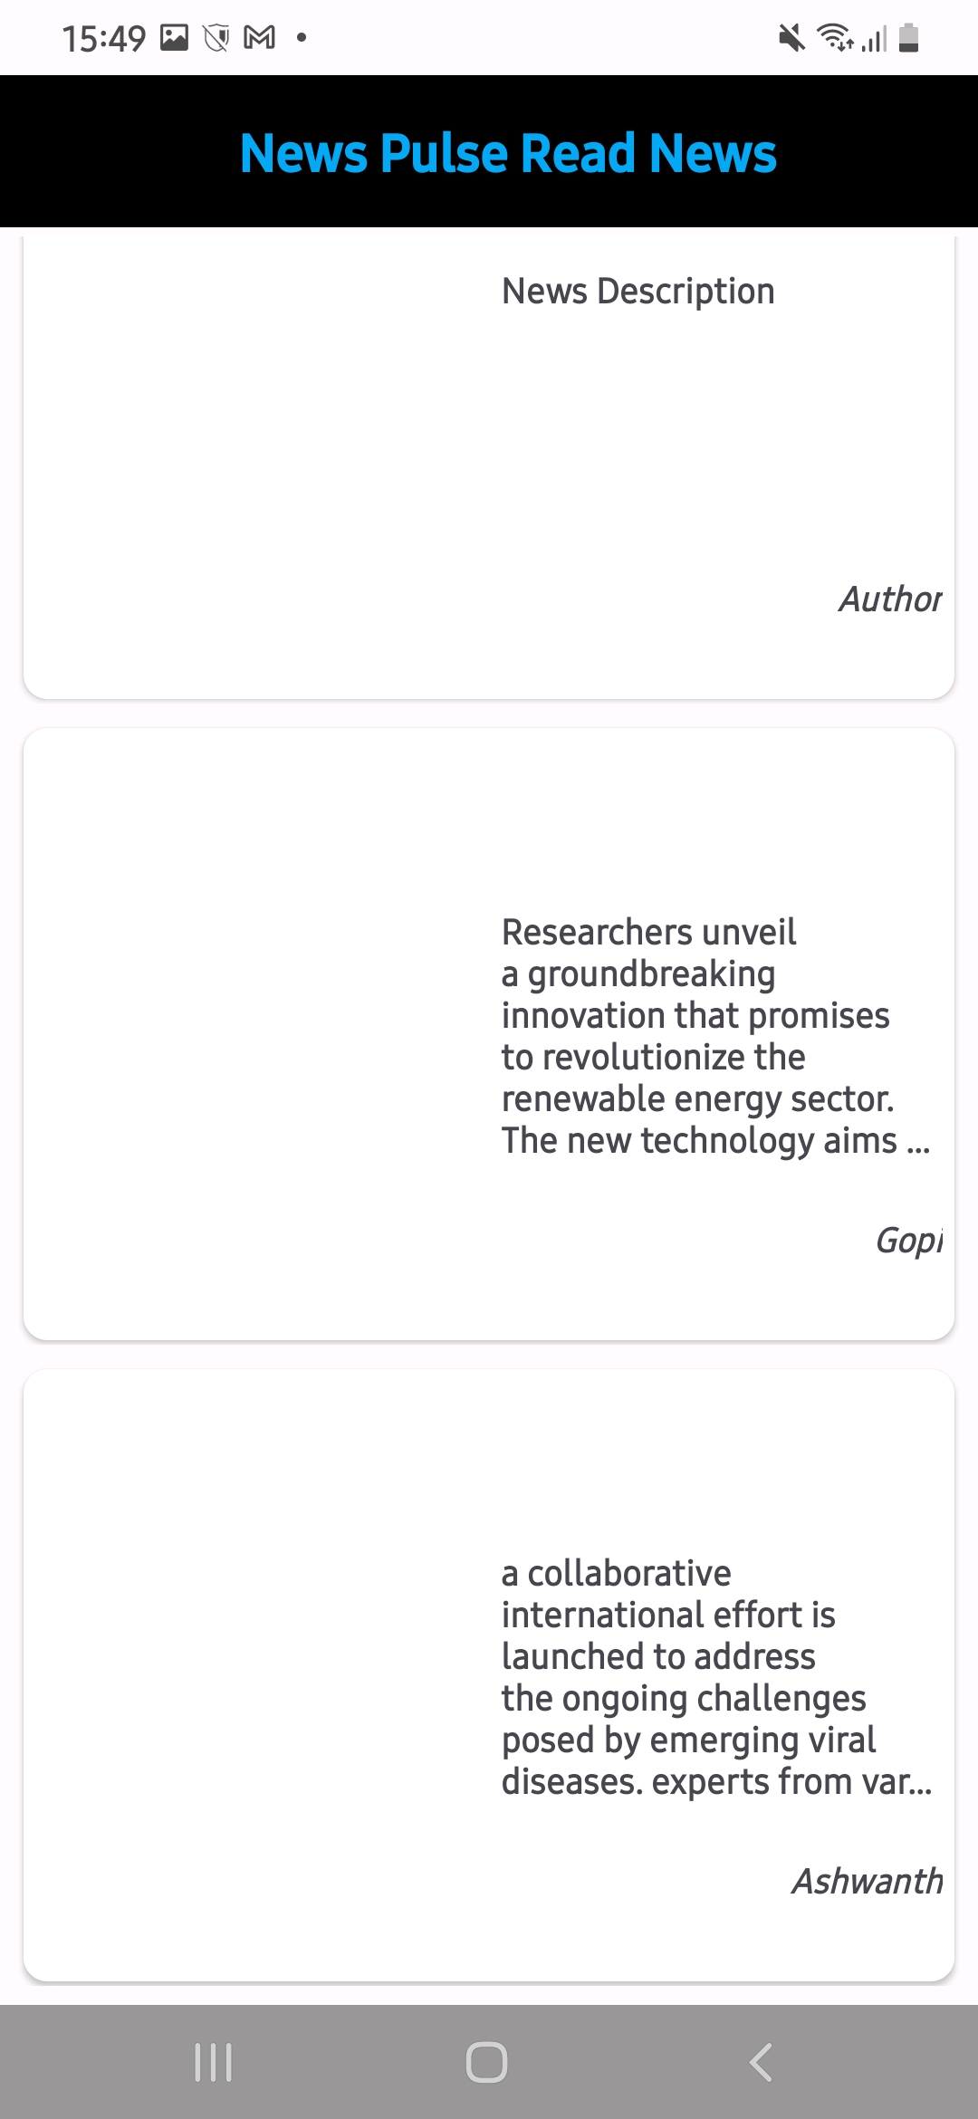
Read News
In the 'Read News' section of News Pulse, users can access and view the content entered in the publishing page, allowing for a seamless and comprehensive reading experience.
Roshini

Slide 11
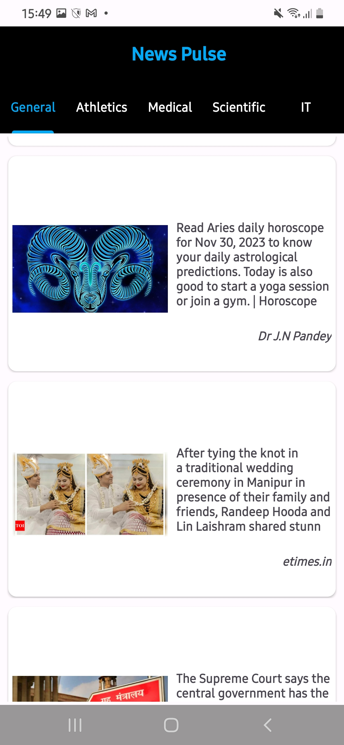
General news
In the 'General News' section of News Pulse, users can explore various fragments showcasing a wide array of news categories, including general news, sports, Bollywood, athletes, and science. Each fragment offers a specialized view tailored to specific interests.
Roshini

Slide 12

persistent data
Firebase can be used for storing some of this persistent data, such as user authentication details and published news articles, ensuring a secure and scalable solution for News Pulse. The implementation may also involve local databases (e.g., SQLite) for efficient storage and retrieval of data on the device.
Gopi

Slide 13
API
The News API (https://newsapi.org/v2/) is used in the provided code snippet to fetch top headlines and category-specific news articles. The methods getNews and getCategoryNews make use of this API to retrieve news based on specified parameters like country, category, page size, and API key.
Gopi

Slide 14
Problems Faced
Overreliance on a Single News API
Security Concerns with API Key Handling
Tejaswini

Slide 15
Future Improvements
Enhanced User Engagement:
Implement features like user comments, social sharing, or personalized notifications to foster community engagement and interaction within the News Pulse app.
Advanced Personalization:
Explore machine learning algorithms to refine and expand the app's personalized news recommendations, providing users with even more tailored content based on their preferences and reading habits.
Tejaswini

Slide 16


Do You Have any Questions?
Tejaswini

